Slide 1
Satellite Communication

Slide 2
Origin/Historical Background

Slide 3
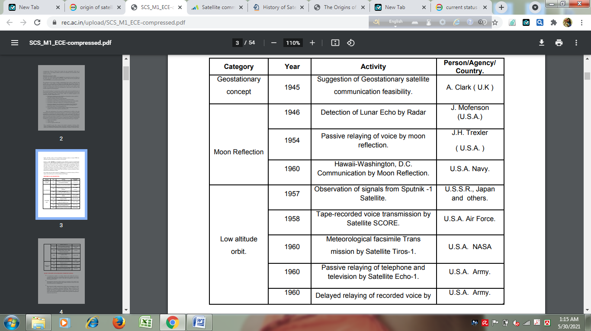

Slide 4
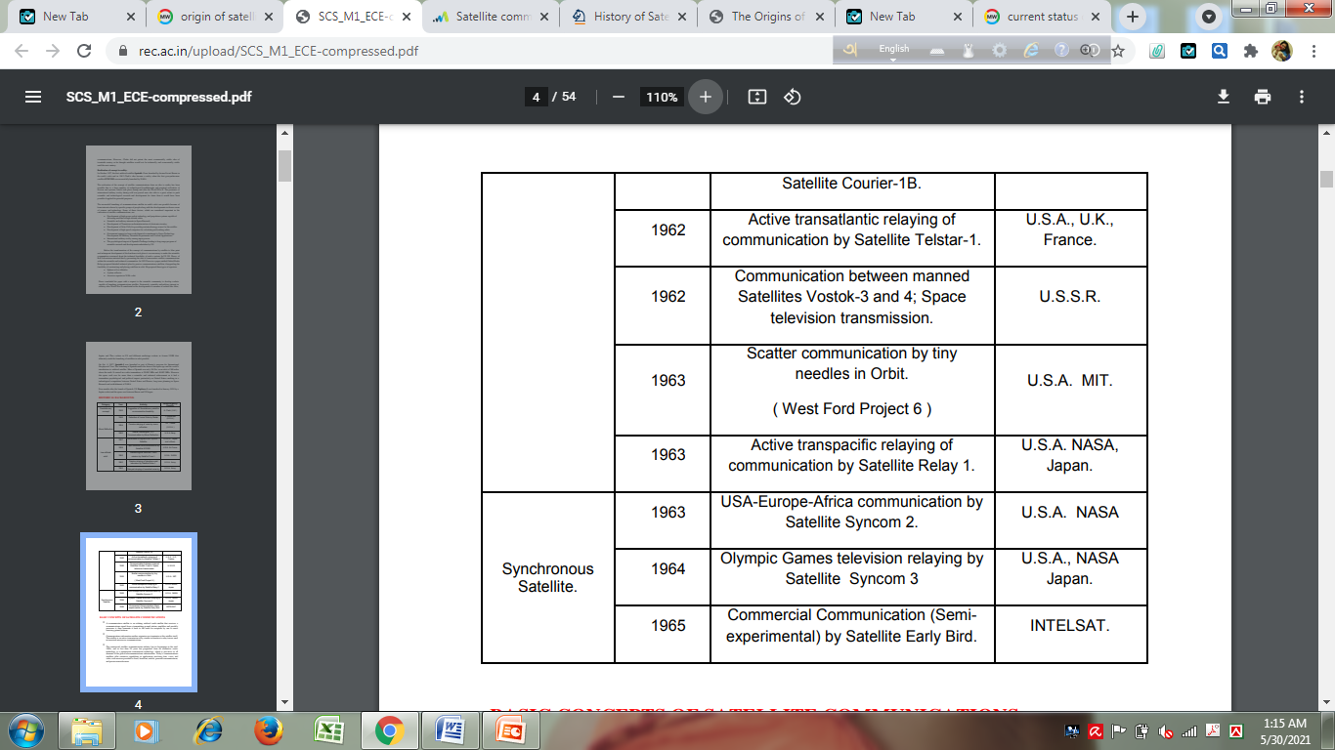

Slide 5
Basic Concept

Slide 6
Satellite
A communication satellite is an orbiting artificial earth satellite that receives a communications signal from a transmitting ground station, amplifies and possibly processes it, then transmits it back to the earth for reception by one or more receiving ground stations.
Communication information neither originates nor terminates at the satellite itself. The satellite is an active transmission relay, similar in function to relay towers used in terrestrial microwave communications.

Slide 7
Current Status
The commercial satellite communications industry has its beginnings in the mid1960s, and in less than 50 years has progressed from an alternative exotic technology to a mainstream transmission technology, which is pervasive in all elements of the global telecommunications infrastructures. Today’s communications satellites offer extensive capabilities in applications involving data, voice, and video, with services provided to fixed, broadcast, mobile, personal communications, and private networks users.

Slide 8
Evolution
 During early 1950s, both passive and active satellites were considered for the purpose of communications over a large distance.
 Passive satellites though successfully used in the early years of satellite communications, with the advancement in technology active satellites have completely replaced the passive satellites.

Slide 9
Passive Satellites
 A satellite that only reflects signals from one Earth station to another or from several Earth stations to several others.
 It reflects the incident electromagnetic radiation without any modification or amplification.
 It can't generate power, they simply reflect the incident power.
 The first artificial passive satellite Echo-I of NASA was launched in August 1960.
Disadvantages:
 Earth Stations required high power to transmit signals.
 Large Earth Stations with tracking facilities were expensive.
 A global system would have required a large number of passive satellites accessed randomly by different users.
 Control of satellites not possible from ground.
 The large attenuation of the signal while traveling the large distance between the transmitter and the receiver via the satellite was one of the most serious problems.

Slide 10
Active Satellites
 In active satellites, it amplifies or modifies and retransmits the signal received from the earth.
 Satellites which can transmit power are called active satellite.
 Have several advantages over the passive satellites.
 Require lower power earth station.
 Not open to random use.
 Directly controlled by operators from ground.
Disadvantages:
 Requirement of larger and powerful rockets to launch heavier satellites in orbit.
 Requirement of on-board power supply.
 Interruption of service due to failure of electronics components.

Slide 11
Two major elements of Satellite Communications Systems
The satellite communications portion is broken down into two areas or segments:
the space segment and
the ground (or earth) segment.

Slide 12
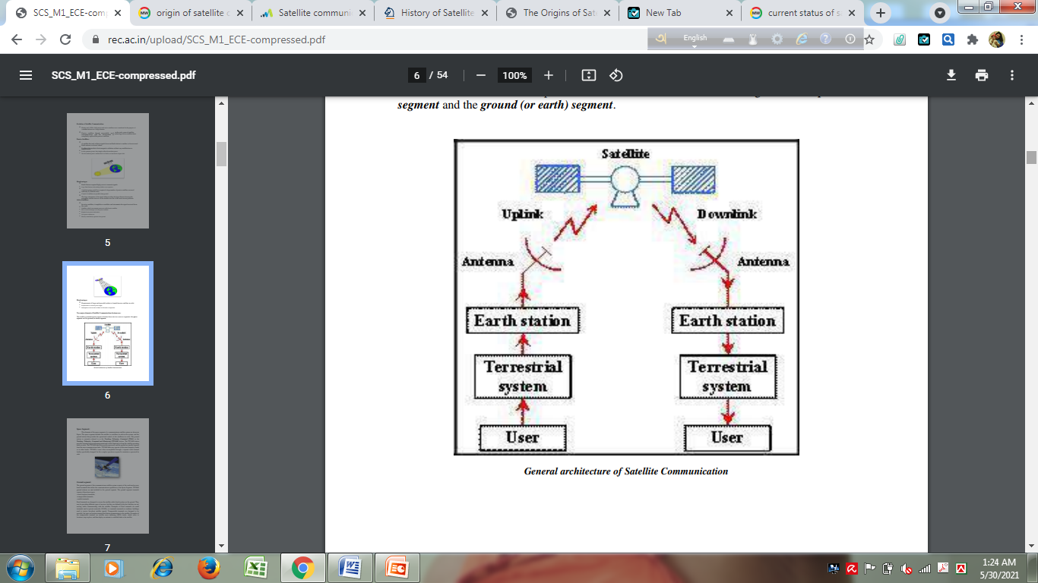

Slide 13
Space Segment
The space segment includes the satellite (or satellites) in orbit.
The ground station that provides the operational control of the satellite(s) in orbit. The ground station is referred to as the Tracking, Telemetry, Command (TT&C) or Tracking, Telemetry, Command and Monitoring (TTC&M) station. The TTC&M station provides essential spacecraft management and control functions to keep the satellite operating safely in orbit.
Tracking determines the spacecraft's position and orbit, while Telemetry transmits data from the satellite, including its status and scientific measurements. Command allows ground control to send instructions to the satellite, and Monitoring assesses the spacecraft's health and performance based on the telemetry data.
The TTC&M links between the spacecraft and the ground are usually separate from the user communications links. TTC&M links may operate in the same frequency bands or in other bands.

Slide 14
Ground Segment
The ground segment of the communications satellite system consists of the earth surface area based terminals that utilize the communications capabilities of the Space Segment. TTC&M ground stations are not included in the ground segment.
The ground segment terminals consist of three basic types:
• fixed (in-place) terminals
• transportable terminals
• mobile terminals

Slide 15
Ground Segment
Fixed terminals are designed to access the satellite while fixed in-place on the ground. They may be providing different types of services, but they are defined by the fact that they are not moving while communicating with the satellite. Examples of fixed terminals are small terminals used in private networks (VSATs), or terminals mounted on residence buildings used to receive broadcast satellite signals.
Transportable terminals are designed to be movable, but once on location remain fixed during transmissions to the satellite. Examples of the transportable terminal are satellite news gathering (SGN) trucks, which move to locations, stop in place, and then deploy an antenna to establish links to the satellite.
Mobile terminals are designed to communicate with the satellite while in motion. They are further defined as land mobile, aeronautical mobile, or maritime mobile, depending on their locations on or near the earth surface.

Slide 16
Satellite Control Centre function
 Tracking of the satellite
 Receiving data
 Eclipse management of satellite
 Commanding the Satellite for station keeping.
 Determining Orbital parameters from Tracking and Ranging data
 Switching ON/OFF of different subsystems as per the operational requirements

Slide 17
Orbital Aspect

Slide 18
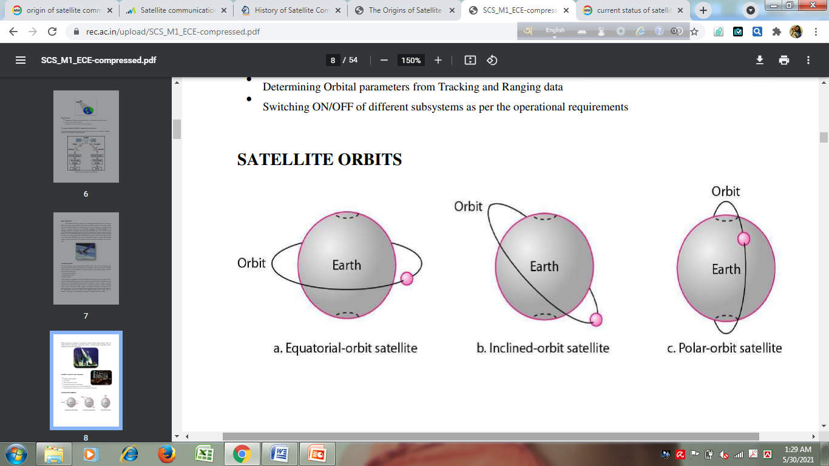
Satellite Orbits

Slide 19
Orbit
The path a Satellite follows around a planet is defined as an orbit.
Satellite Orbits are classified in two broad categories
➢ Non-Geostationary Orbit (NGSO)
➢ Geo Stationary Orbit (GSO)
Non-Geostationary Orbit (NGSO)
Early ventures with satellite communications used satellites in Non-geostationary low earth orbits due to the technical limitations of the launch vehicles in placing satellites in higher orbits.
Disadvantages of NGSO
 Complex problem of transferring signal from one satellite to another.  Less expected life of satellites at NGSO.
 Requires frequent replacement of satellites compared to satellite in GSO

Slide 20
Orbit
Geo Stationary Orbit (GSO):
A geostationary orbit is a type of geosynchronous orbit. A geosynchronous orbit can be any orbit, like with an elliptical path, that has a period equal to the Earth’s rotational period, whereas a geostationary orbit has to be a circular orbit and that too placed above the equator.
 There is only one geostationary orbit possible around the earth. Lying on the earth’s equatorial plane. The satellite orbiting at the same speed as the rotational speed of the earth on its axis.
Advantages:
 Simple ground station tracking.
 Nearly constant range
 Very small frequency shift
Disadvantages:
 Transmission delay of the order of 250 msec.
 Large free space loss
 No polar coverage

Slide 21
Satellite orbits in terms of the orbital height
According to distance from earth, satellite orbits can be classified into three categories.
 Geosynchronous Earth Orbit (GEO)
 Medium Earth Orbit (MEO)
 Low Earth Orbit (LEO)
Geostationary or geosynchronous earth orbit (GEO):
GEO satellites are synchronous with respect to earth. Looking from a fixed point from Earth, these satellites appear to be stationary. These satellites are placed in the space in such a way that only three satellites are sufficient to provide connection throughout the surface of the Earth (that is; their footprint is covering almost 1/3rd of the Earth). The orbit of these satellites is circular. Lifetime expectancy of these satellites is 15 years.

Slide 22
Satellite orbits in terms of the orbital height
There are three conditions which lead to geostationary satellites.
The satellite should be placed 35,786 kms (approximated to 36,000 kms) above the surface of the earth.
These satellites must travel in the rotational speed of earth, and in the direction of motion of earth, that is eastward.
The inclination of satellite with respect to earth must be 0°.
Geostationary satellite in practical is termed as geosynchronous as there are multiple factors which make these satellites shift from the ideal geostationary condition.
Gravitational pull of sun and moon makes these satellites deviate from their orbit. Over the period of time, they go through a drag. (Earth’s gravitational force has no effect on these satellites due to their distance from the surface of the Earth.)

Slide 23
Satellite orbits in terms of the orbital height
2) These satellites experience the centrifugal force due to the rotation of Earth, making them deviate from their orbit.
3) The non-circular shape of the earth leads to continuous adjustment of speed of satellite from the earth station. These satellites are used for TV and radio broadcast, weather forecast and also, these satellites are operating as backbones for the telephone networks.
Disadvantages:
Northern or southern regions of the Earth (poles) have more problems receiving these satellites due to the low elevation above a latitude of 60°, i.e., larger antennas are needed in this case. The transmit power needed is relatively high which causes problems for battery powered devices.
These satellites cannot be used for small mobile phones. The biggest problem for voice and also data communication is the high latency as without having any handovers, the signal needs to travel 72,000 kms.
Due to the large footprint, either frequencies cannot be reused or the GEO satellite needs special antennas focusing on a smaller footprint.

Slide 24
Satellite orbits in terms of the orbital height
Advantages Of GEO
 Minimal Doppler shift
 These factors make it ideal for satellite broadcast and other multipoint applications
 GEO satellites have a 24 hour view of a particular area.
 A GEO satellite’s distance from earth gives it a large coverage area.
Medium Earth Orbit (MEO) satellites:
MEOs can be positioned somewhere between LEOs and GEOs, using orbits around 20,000 km (8,000-20,000 km above the earth). The system only requires a dozen satellites which is more than a GEO system, but much less than a LEO system. These satellites move more slowly relative to the earth’s rotation allowing a simpler system design (satellite periods are about six hours). Depending on the inclination, a MEO can cover larger populations, so requiring fewer handovers.

Slide 25
Satellite orbits in terms of the orbital height
Advantages
• A MEO satellite’s longer duration of visibility and wider footprint means fewer satellites are needed in a MEO network than a LEO network.
Disadvantages
• A MEO satellite’s distance gives it a longer time delay and weaker signal than a LEO satellite, though not as bad as a GEO satellite.
Examples: The GPS constellation calls for 24 satellites to be distributed equally among six circular orbital planes.

Slide 26
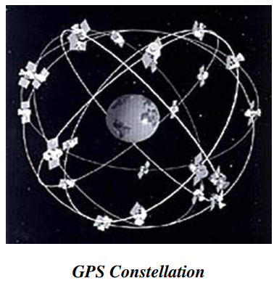

Slide 27
Satellite orbits in terms of the orbital height
Low Earth Orbit (LEO) satellites:
These satellites are placed 500-2000 km above the surface of the earth. As LEOs circulate on a lower orbit, hence they exhibit a much shorter period that is 95 to 120 minutes. LEO systems try to ensure a high elevation for every spot on earth to provide a high quality communication link. Each LEO satellite will only be visible from the earth for around ten minutes. Using advanced compression schemes, transmission rates of about 2,400 bit/s can be enough for voice communication. LEOs even provide this bandwidth for mobile terminals with Omni-directional antennas using low transmit power in the range of 1W. The delay for packets delivered via a LEO is relatively low (approx 10 ms). The delay is comparable to long-distance wired connections (about 5–10 ms). Smaller footprints of LEOs allow for better frequency reuse, similar to the concepts used for cellular networks. LEOs can provide a much higher elevation in Polar Regions and so better global coverage. These satellites are mainly used in remote sensing an providing mobile communication services (due to lower latency).

Slide 28
Satellite orbits in terms of the orbital height
Disadvantages:
The biggest problem of the LEO concept is the need for many satellites if global coverage is to be reached. Several concepts involve 50–200 or even more satellites in orbit. The short time of visibility with a high elevation requires additional mechanisms for connection handover between different satellites. The high number of satellites combined with the fast movements resulting in a high complexity of the whole satellite system. One general problem of LEOs is the short lifetime of about five to eight years.
Other factors are the need for routing of data packets from satellite to users due to small footprint. Due to the large footprint, a GEO typically does not need this type of routing, as senders and receivers are most likely in the same footprint.

Slide 29
Satellite orbits in terms of the orbital height
Example: The Iridium system has 66 satellites in six LEO orbits, each at an altitude of 750 km.
Advantages of LEO:
• A LEO satellite’s proximity to earth compared to a GEO satellite gives it a better signal strength and less of a time delay, which makes it better for point to point communication.
Disadvantages Of LEO:
• A network of LEO satellites is costly.
• LEO satellites have to compensate for Doppler shifts cause by their relative movement.
• Atmospheric drag effects LEO satellites, causing gradual orbital deterioration.

